Slide 1
Introduction to Paddle Boarding
Kimberly Hedges
LDT 7111

Slide 2
Introduction
Paddle boarding is a fairly new water sport that has helped countless people find their inner peace and physical strength. The class is intended for adults who have minimal experience with paddle boarding or similar water sports. The course will take place on open water such as a large pool, lake, or ocean. It can also be adapted to cover locations that are high vacation spots or an area where residents are interested in starting a new hobby.
The participants prerequisites include knowing how to swim and willingness to wear a life jacket while in the water.
This Photo by Unknown Author is licensed under CC BY-NC-SA

Slide 3
Meet the Participants
Cynthia
32 years Old
Single mother of a six-year-old
Cynthia is recently divorced
Moved to Southeast Michigan from Iraq when she was three
Chaldean
Graduated from MSU with a nursing degree
Cynthia’s husband of eight years left her six months ago for a twenty-two-year-old coworker. She has been extremely depressed since the life changing event and has not been the mother she knows her daughter deserves. After some self-reflection she has decided that it is time for her to get back to being the outgoing happy person she once was. She decided to take up paddle boarding to begin her journey to being sane once again. Cynthia is also taking up the paddle boarding class to get some much-needed exercise, which she has also neglected.

Slide 4
Meet the Participants
John
26 years old
Graduated from SDSU three years ago with a degree in business
Christian
Born and raised in San Diego, California
Works in Ann Arbor, Michigan
John has quickly risen the corporate ladder at work and is able to do much of his work from home or by satellite which gives him the opportunity to travel. He is very much in love with Jen and is planning on proposing to her on their next hiking trip under the Northern Lights. He came up with this idea of paddle boarding because he could not leave on a trip for a couple months and his goal in life right now is to keep Jen happy. John also used to surf in San Diego, so he is comfortable with his ability to pickup paddle boarding quickly.

Slide 5
Meet the Participants
Jen
23 years old
Graduated from WSU last year with her teaching degree
Substitute Teacher
To subsidize her income, she also bartends
Met John at her bartending job
Born and raised in New Boston, Michigan
Jen loves to travel and enjoys all kinds of outdoor activities. She loves John very much and still gets those butterflies in her stomach when she sees him. Jen hopes that he proposes to her soon so that they can start focusing on being married and having kids. Although she loves to be adventurous and her freedom, nothing would make her happier than being the best wife and mother to John and their children.

Slide 6
Meet the Participants
George
29 years old
Regular guy
Works for Comcast doing installation
Single
Catholic and has never missed Mass
Born and raised in Warren, Michigan
George would eventually like to find someone, but it isn’t a priority to hunt for love. He has a good family, and he is always over at his parent’s house helping them with anything they need. George has a great life and is content with everything. He decided to take the paddle boarding class because he likes to try new things and was looking for a new hobby for his free time.

Slide 7
Course Table of Contents
Module One
Introduction and Ice Breaker
Module Two
Rewards of paddle boarding
Mental Relaxation
Peace
Exercise
Module Three
Safety while in the water
Awareness of rip currents
Awareness of distance from shore
Depending on type of water, know potential animal dangers
Module Four
Five Key Steps to Paddle Boarding
Module Five
Independent paddling
Module Six
Review and Ball Toss Explaining Course Content

Slide 8
Module One Course Ice Breakers
The introduction activity will consist of participants playing Two Truths and a Lie to introduce themselves. This activity is a way to allow the learners to establish a comfortable setting for everyone.
Here is an example of the ice breaker:
After the ice breaker has been completed the instructor will go over the prerequisites of knowing how to swim and the importance of using the life jacket while in the water.
This Photo by Unknown Author is licensed under CC BY-SA

Slide 9
Module Two Rewards of Paddle Boarding
Learning Outcome: Students will understand the rewards of paddle boarding
Educational Activity:
Buzz Session:
This activity will begin with the instructor asking the learners to silently think about the reasons they are taking up paddle boarding. Once they have thought about their reasons for taking the class they are going to discuss with each other why they are taking the course. After the discussion amongst themselves they will report to the instructor their top three reasons they have agreed upon and report it to the instructor. At this point the instructor will touch upon their reasons and guide them towards the other reasons in which the course was designed mental relaxation, inner peace, and exercise.
Assessment: Oral questions and demonstrations on proper form and techniques.

Slide 10
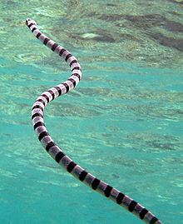
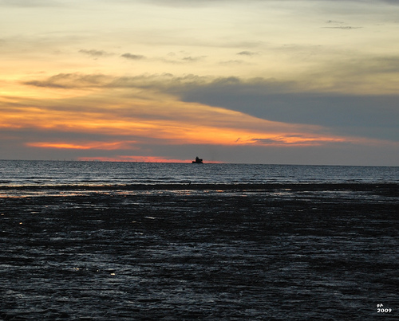
Module Three Safety While in the Water
Learning Outcome: Students will learn the importance of safety while in the water
Educational Activity:
Lecture and Questioning
Participants will listen to a short presentation that contains visual aids that present the dangers of water sports: rip currents, awareness of distance from shore, and dangerous animals in the water. The learners will then take a multiple choice/ short answer quiz that demonstrates their understanding of the safety issues that may be present in the water.
Assessment: Short answer and multiple-choice questions after a short informational instruction presentation with posters

Slide 11
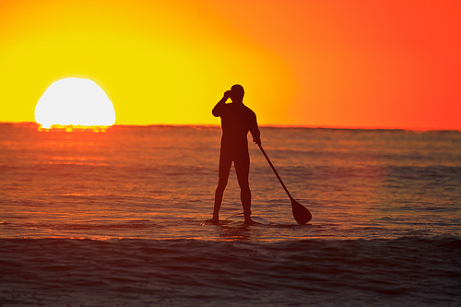
Module Four Five Key Steps
Learning Content: Students will be demonstrating knowledge of the five key steps to paddle boarding.
Educational Activity:
Modeling and Demonstration: Students will demonstrate understanding of paddle boarding by mimicking the instructor’s technique for proper paddle boarding form. The students will demonstrate their understanding and ability of paddle boarding by:
1. Pulling self-up on the board without falling off
2. Swiftly standing on board without losing balance
3. Standing with feet hip width apart and using core muscles for best body weight distribution to keep balance
4. Using the paddle to move smoothly through the water without losing balance and falling off
5. Finally learners will intentionally fall off the board to demonstrate understanding of falling safely and avoiding injury.
Assessment: Observation after instructor demonstrates the appropriate technique (This can be done in a round robin format where students all demonstrate their understanding).

Slide 12
Module Five Independent Paddling
Learning Outcome: Students will paddle board independently by recalling the five key steps to paddle boarding.
Educational Activity:
Independent Practice
During this activity students will be paddle boarding on their own with minimal guidance from the instructor. The participants will take the board out into the water and demonstrate their understanding of the five key topics of the course: pull self-up on board, swiftly stand on board, proper standing form on board, paddle on board, and safely fall off board. This activity is designed so that the individuals will become comfortable on their own doing the activity.
Assessment:
Checklist: Students properly board the paddle board, stand on paddle board, demonstrate proper standing form, paddle correctly, and fall safely.

Slide 13
Module Six Course Review and Wrap Up
After students have mastered the independent paddle boarding portion of the course the instructor will call the group back to the beach to review what was learned.
The class will review the five key steps of paddle boarding and the importance of knowing the risks of being in the water.
Finally, the course will close with a ball toss where each participant explains where they plan to go paddle boarding next when the ball is thrown to them. This activity will allow the participants to reflect on what they want to do with the information they have learned.

